Slide 1
Master Thesis Project: Bending-Twist Shape Adaptation of Wings by Compliant Chiral Spar Design
Alejandro Valverde López, Cranfield University
Advisors: Runkel, Falk; Keidel, Dominic; Urban Fasel

Slide 2
Presentation outline
Motivation
Working principle
Analytical and computational model description
Structure response characterization from simulations
Conclusions and outlook

Slide 3
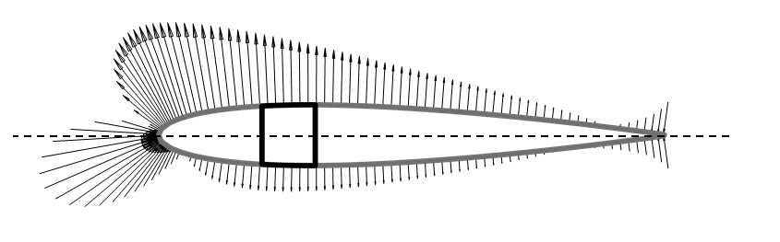

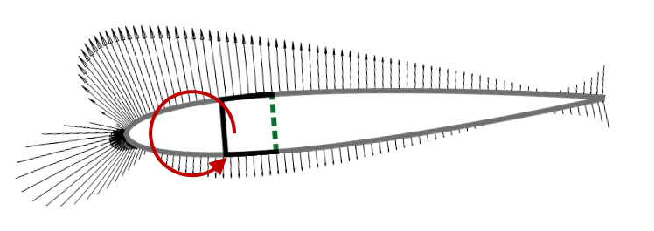
Motivation
Wing demonstrator
Gust alleviation
Fig 1: Wing demonstrator, Raither (2013)
Fig 2: Gust alleviation mechanism

Slide 4
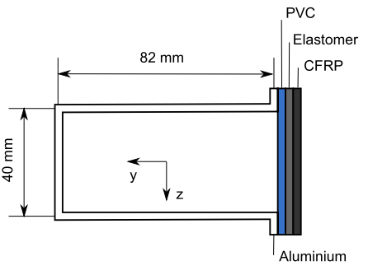
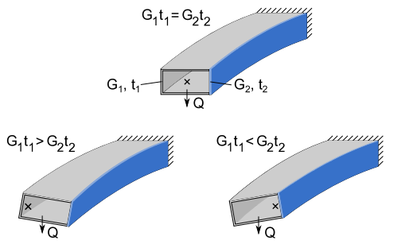
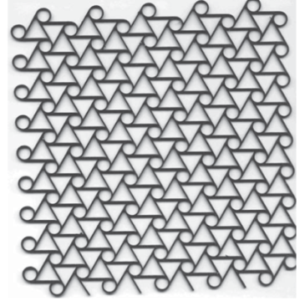
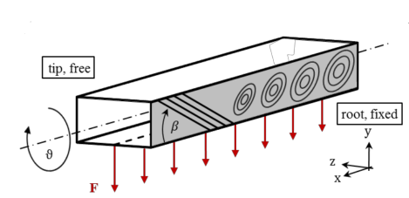
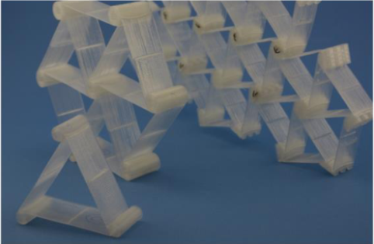
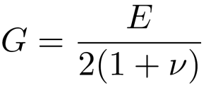
Different approaches
ΔT → G₂ t₂
Working principle, publicated on: Raither(2013)
Fig 4: Variable elastic modulus of the polymer web due to temperature changes, Raither (2012)
Fig 3: Working principle, Raither (2013)
Current project: Buckling-induced shear modulus variation
Runkel (2015): Δβ → material anisotropy
Fig 6: Chiral structures in lattice
Fig 5: Time-variable lamination in laminate composite shells, Raither (2012)
Notes:
Working principle
The variable shear stiffness G2t2 that is required for the activation of the adaptive web can in principle be achieved by changing either the web’s shear modulus or its thickness. The change in shear stiffness of the adaptive web will lead to a shift of the shear center in horizontal direction and thus to a non-zero twist of the profile.
Case 1-Raither: - ACTIVE
An implementation based on the variation of the elastic modulus of a polymer web due to changes in temperature is investigated.
Case 2-Runkel: - PASSIVE
A particular material anisotropy by varying fibre orientation and thickness of the component is introduced.
Case 3-Chiral:
At a particular external load, the shear flow in the web exceeds the buckling limit, resulting in a drastic reduction of the effective shear modulus of this structural element

Slide 5
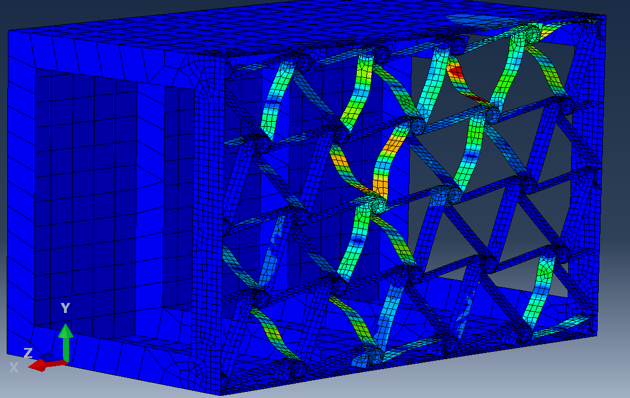
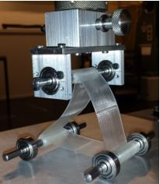
Working principle for the proposed technology
Elastic instabilities induced on the chiral elements ligaments
Reduction of the overall shear modulus G₂ for the lattice of chiral structures
Effectively an effective shear modulus G_{2,eff} is introduced
G_{2,eff} <G₁
Fig 7: Induced elastic instabilities in the chiral elements that provoke a wing twist adaptation
Fig 8: Compression load test on a basic triangular chiral structure Ramstein (2016)

Slide 6
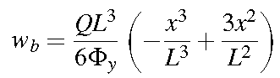
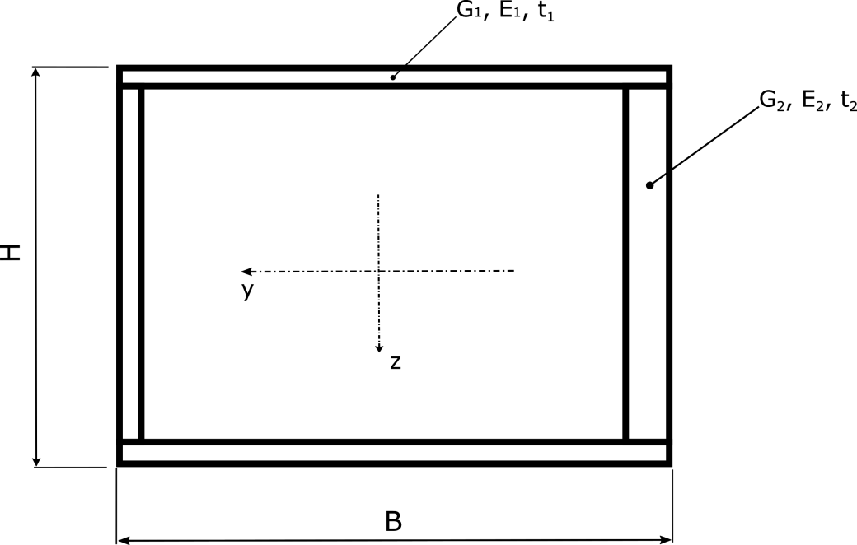
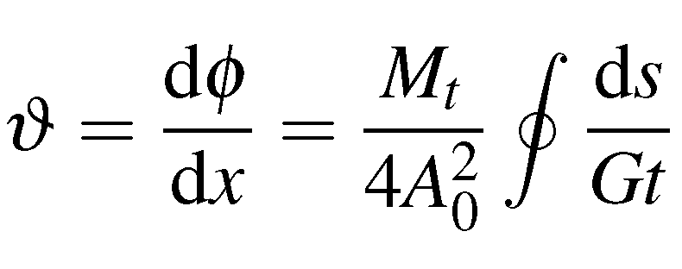
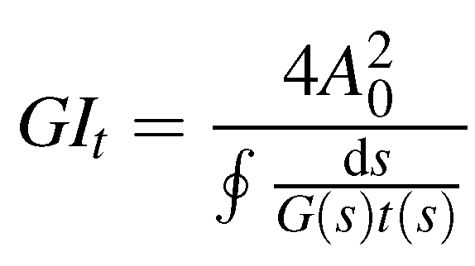
Analytical model
Used to provide fast insight of the role of each of the design parameters on the final mechanical properties of the beam
Bending deformation provided by Bernoulli-Euler equation:
Specific twist due to torsion provided by St. Venant equation:
Torsional stiffness:
Fig 9: Analytical model of the closed section beam

Slide 7
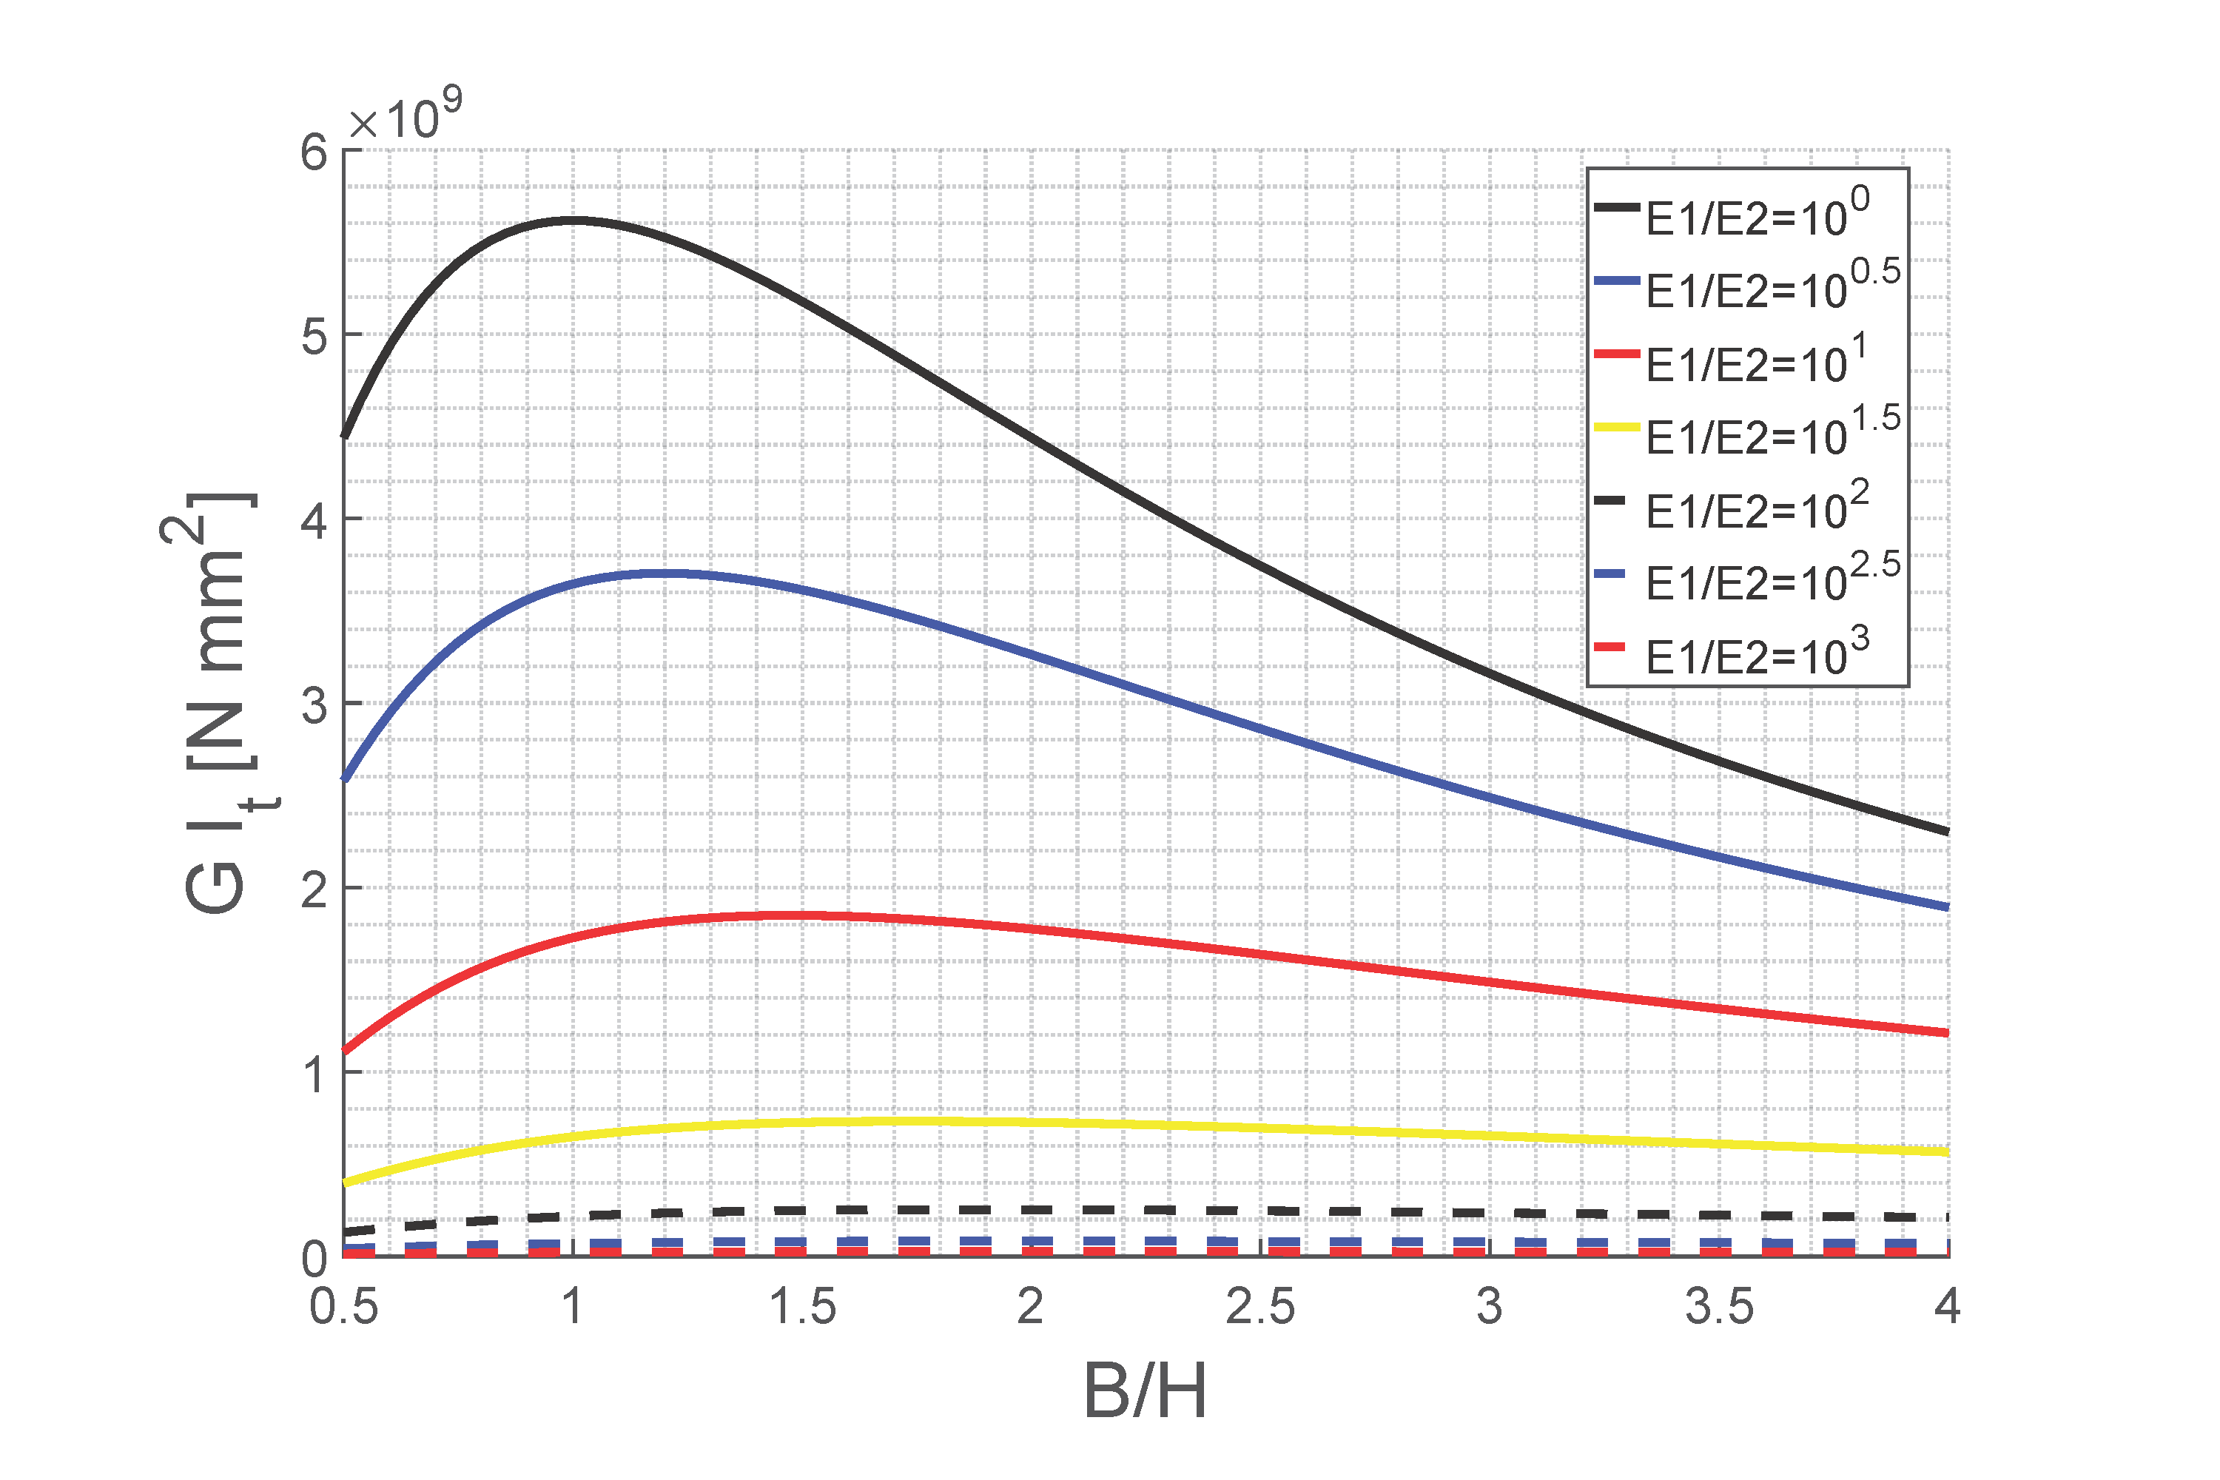
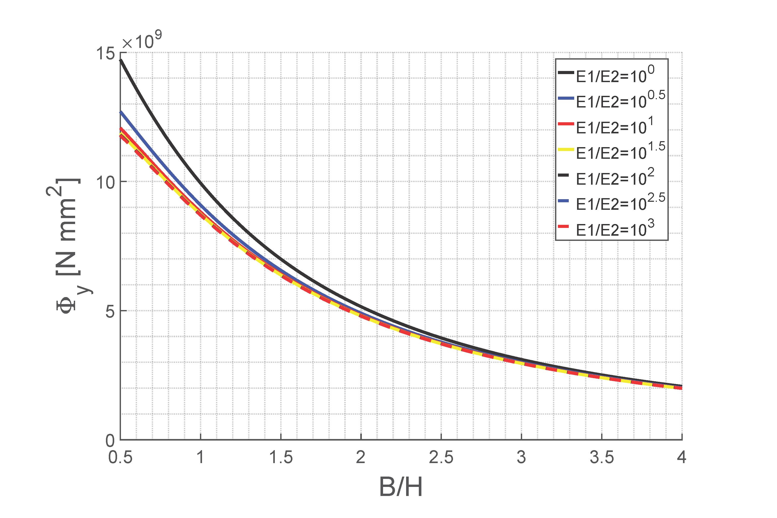
Results from the study on the analytical model
Preliminary results
Fig 10: Influence of the cross-sectional aspect ratio B/H on the torsional stiffness G I_{t} , shown for various values of the stiffness ratio E₁ / E₂
Fig 11: Influence of the cross-sectional aspect ratio B/H on the flexural stiffness Φ_{y}, shown for various values of the stiffness ratio E₁ / E₂

Slide 8
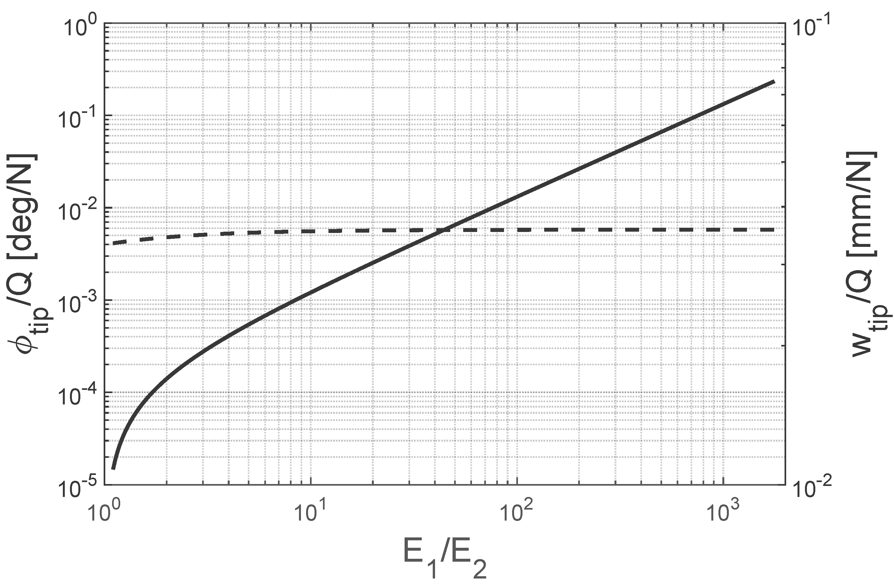
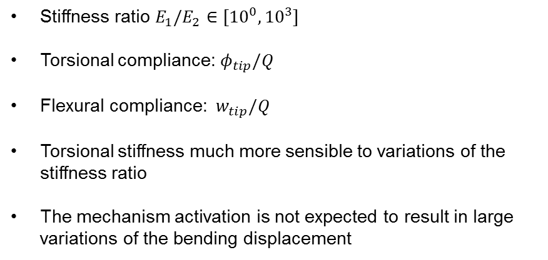
Results from the study on the analytical model
Preliminary results
Stiffness ratio $E_{1}/E_{2}$ $∈[{10}^{0}, {10}^{3}]$
Torsional compliance: $φ_{tip}/Q$
Flexural compliance: ${ w}_{tip}/Q$
Torsional stiffness much more sensible to variations of the stiffness ratio
The mechanism activation is not expected to result in large variations of the bending displacement
Fig 12: Torsional and flexural compliances as a function of the stiffness ratio

Slide 9
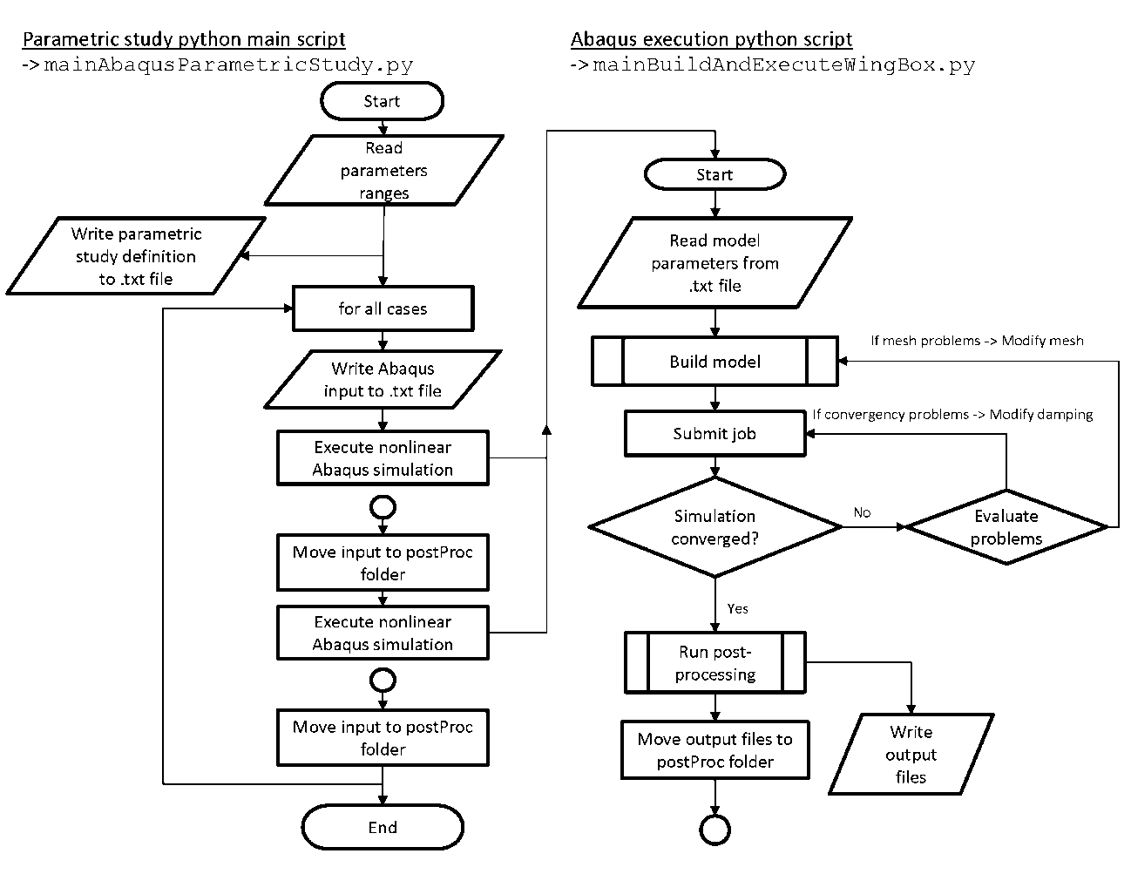
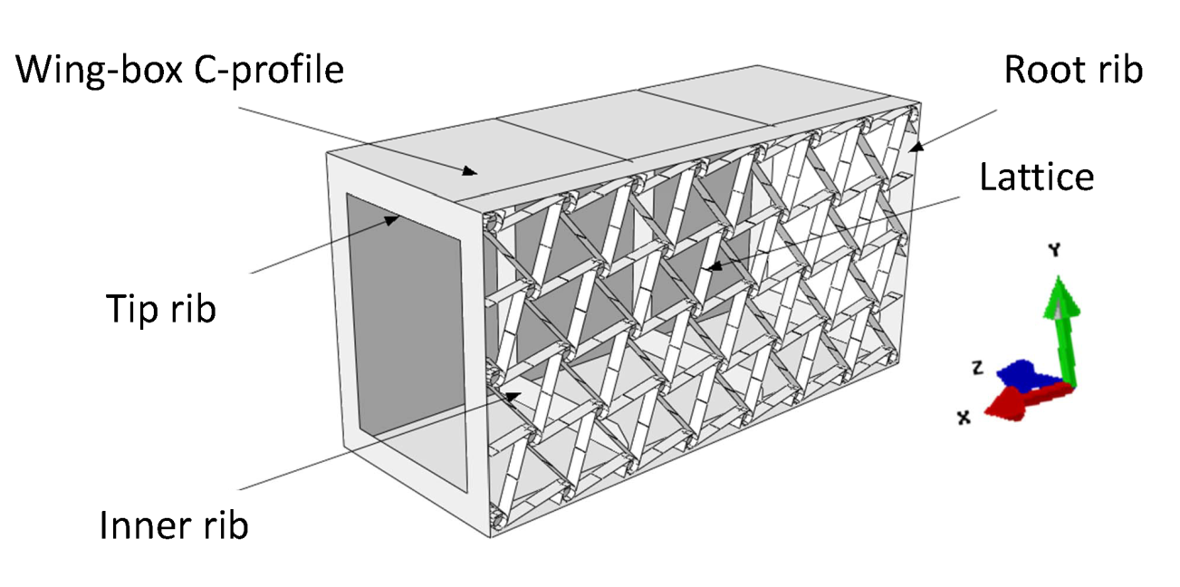
Computational model
The structure response was obtained executing nonlinear simulations on Abaqus CAE
Program using Python scripting
Fig 14: General assembly of the computational model
Fig 13: Flow chart showing the execution of the parametric study python code

Slide 10
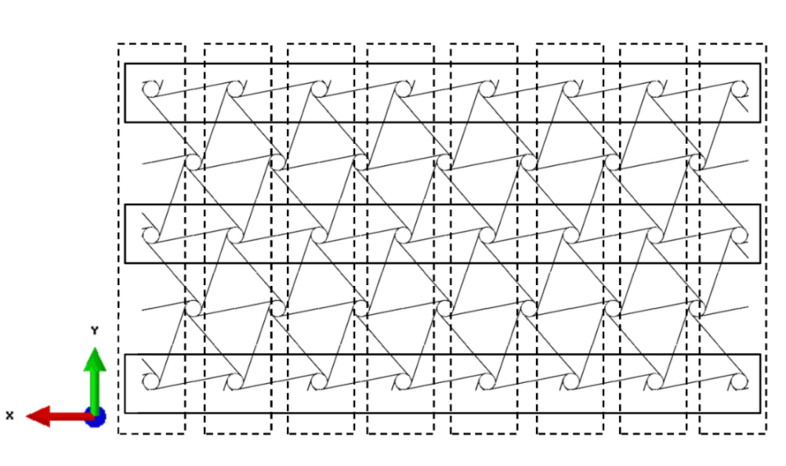
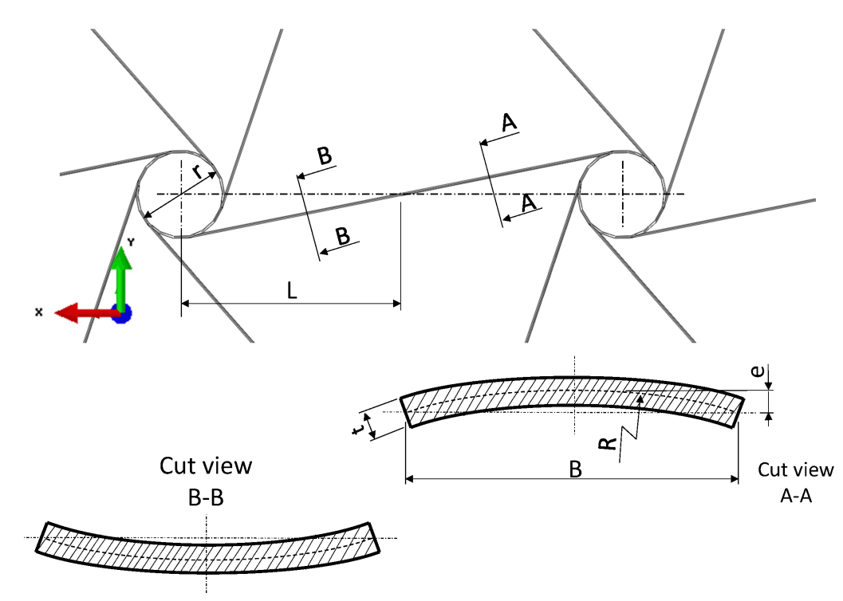
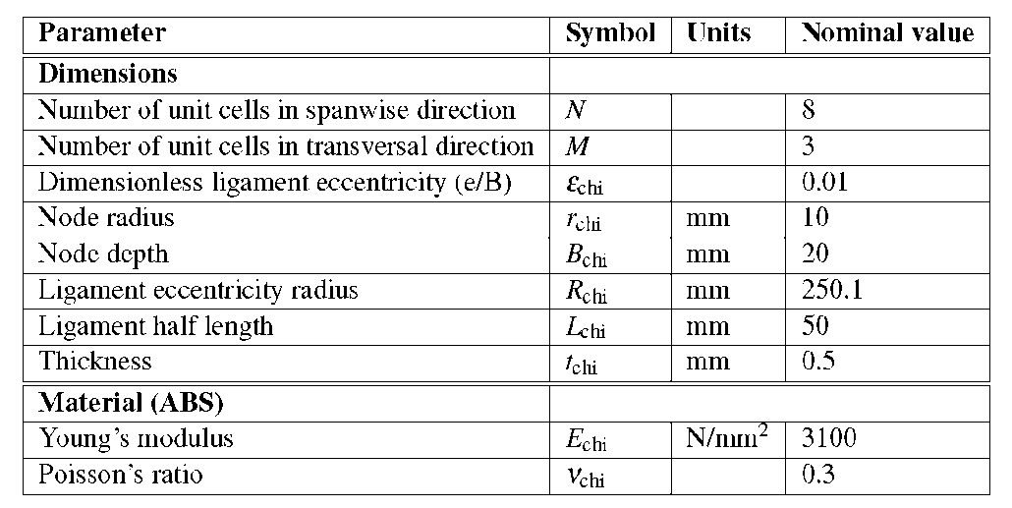
Computational model
Chiral structure description
Fig 16: Division of the chiral structure en N and M unit cells
Fig 15: Internal parameters for the chiral structure design
Fig 17: Parameters used in the chiral structure lattice design

Slide 11
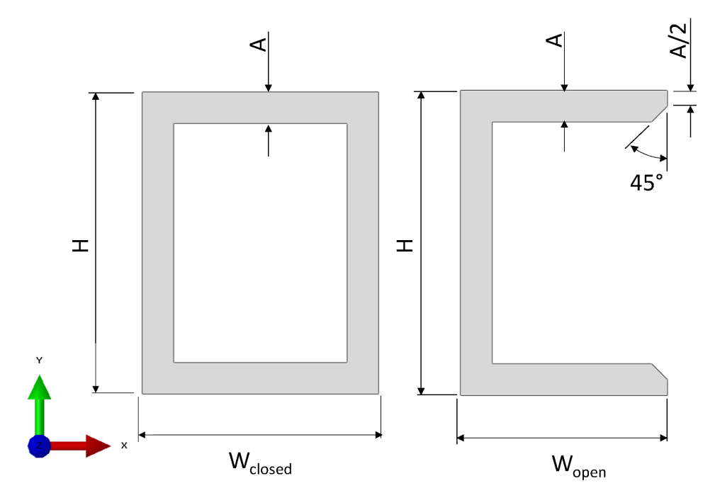
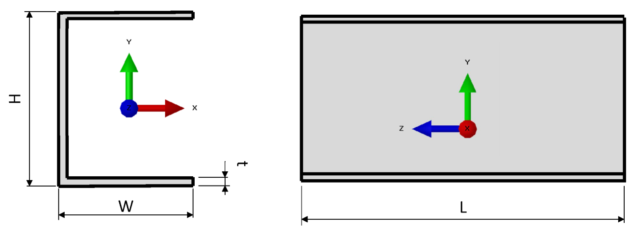
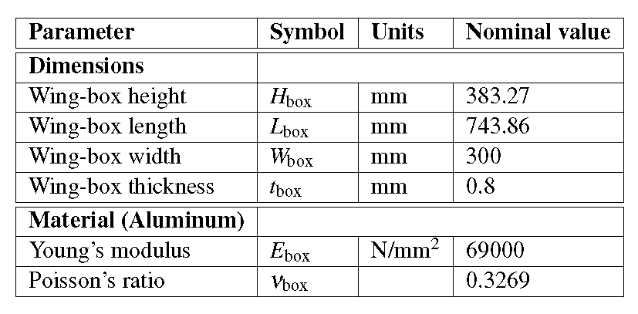
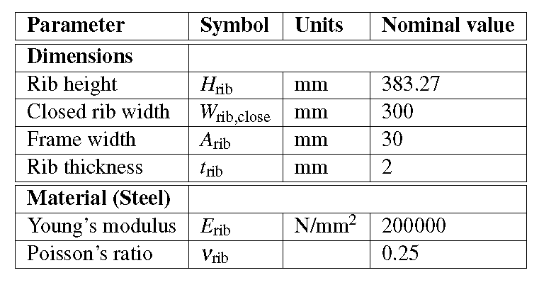
Computational model
Wing-box in C-profile and ribs
Fig 18: Characteristic dimensions of the wing-box design
Fig 20: Characteristic dimensions of ribs design
Fig 19: Parameters used in the chiral structure lattice design
Fig 21: Parameters used in the ribs design

Slide 12

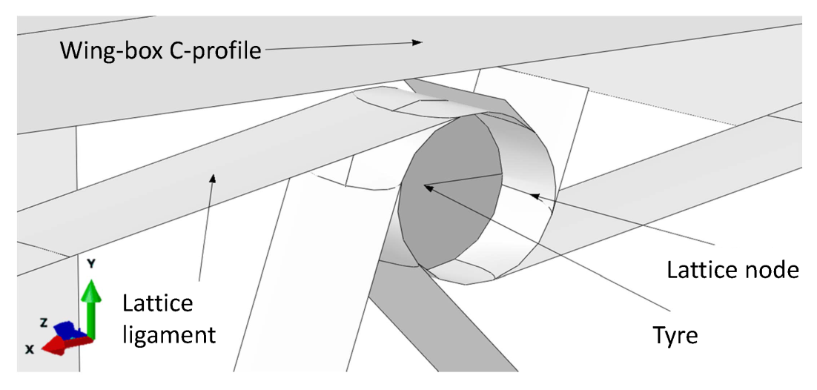
Computational model
Chiral lattice nodes rigid modeling
Lattice nodes are only constraint in rotation around its one axis by the lattice ligaments
In the modelling, they are assumed to behave like rigid bodies
Fig 22: Tyre embedded into the lattice chiral node
Fig 23: Chiral nodes on the manufactured demonstrator, Vincenz (2016)

Slide 13
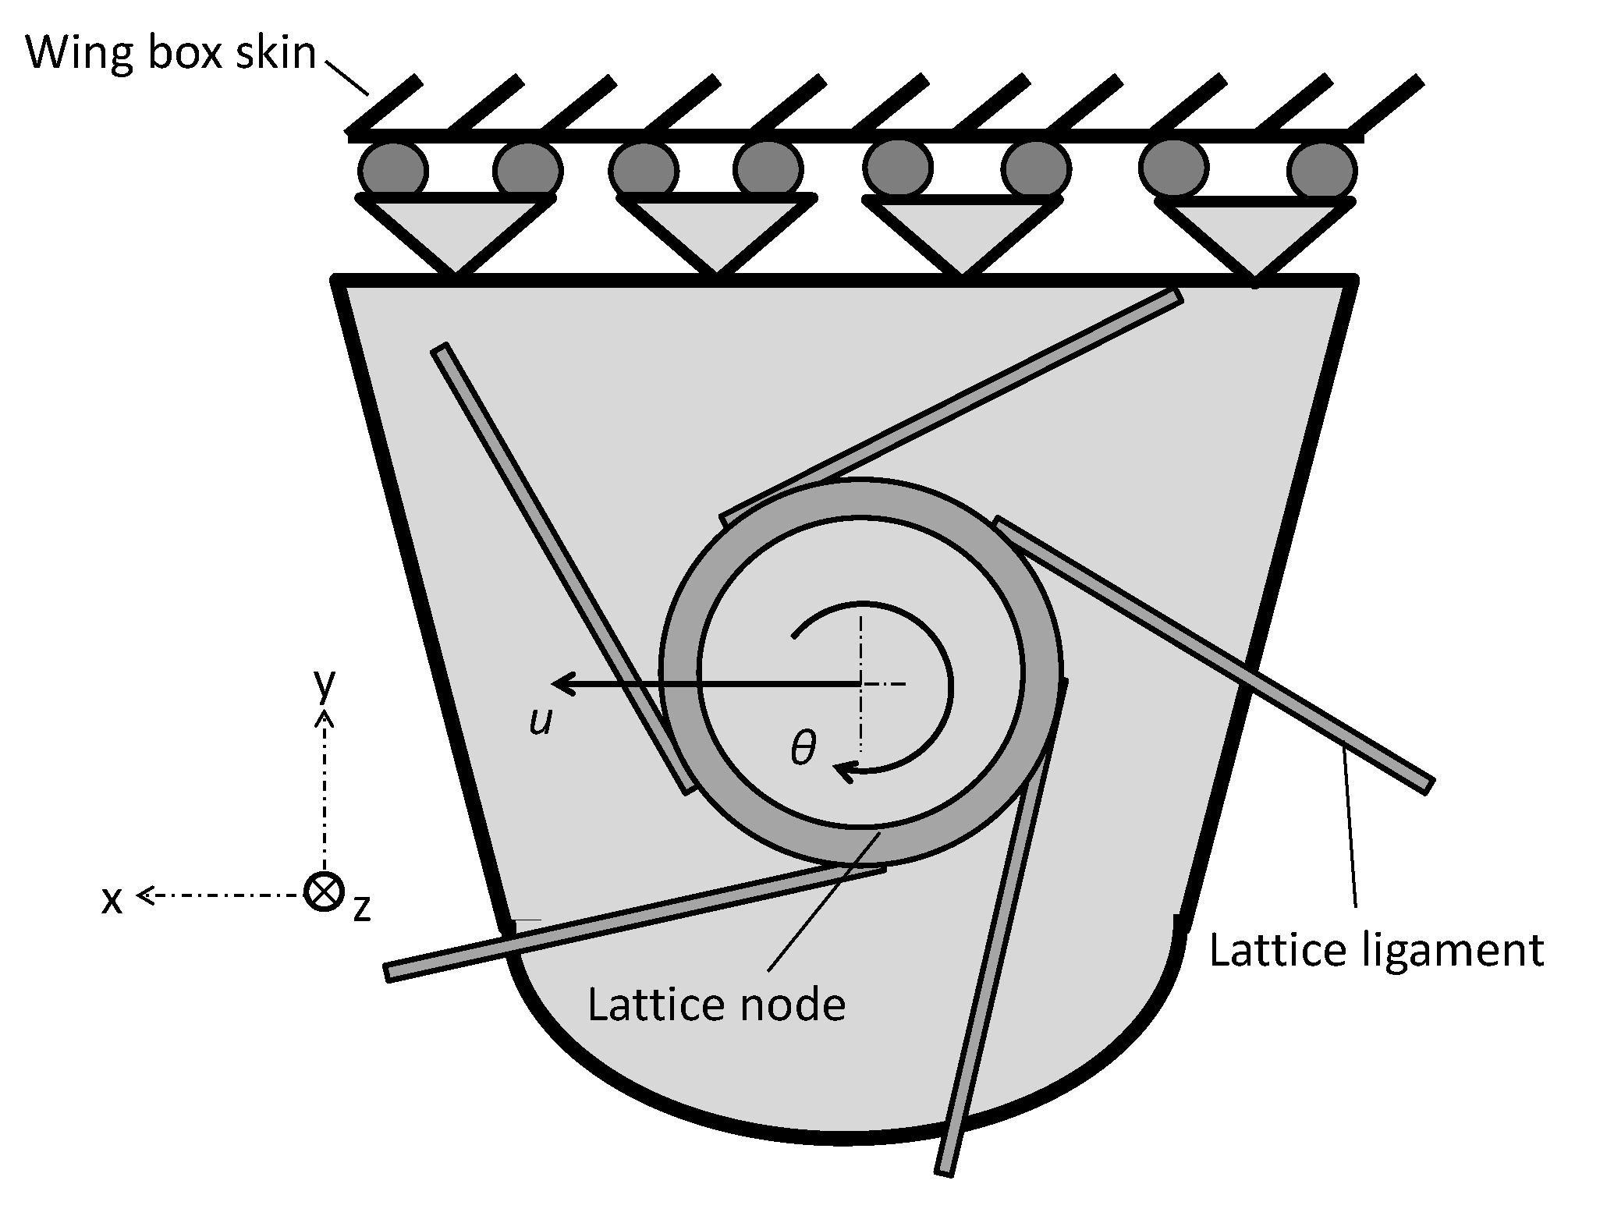
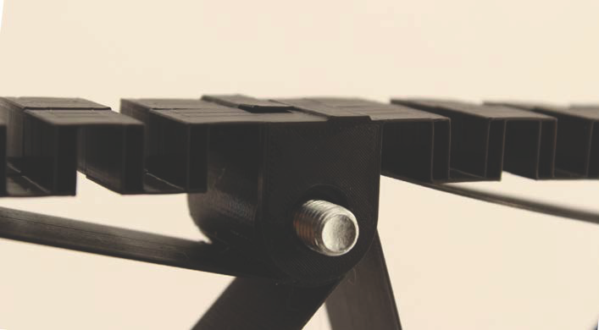
Computational model
Connection between the chiral lattice and wing-box skin
Unavoidable transition from the lattice of chiral structures comprised of nodes and ligaments to the skin of the wing-box
Loads are transmitted to the lattice through this attachment points that is why its design results crucial
Degrees of freedom unconstrained: u and θ
Fig 24: Sketch of the connection between the chiral node
Fig 25: Connection between the chiral lattice and the skin on the manufactured demonstrator, Vincenz (2016)

Slide 14
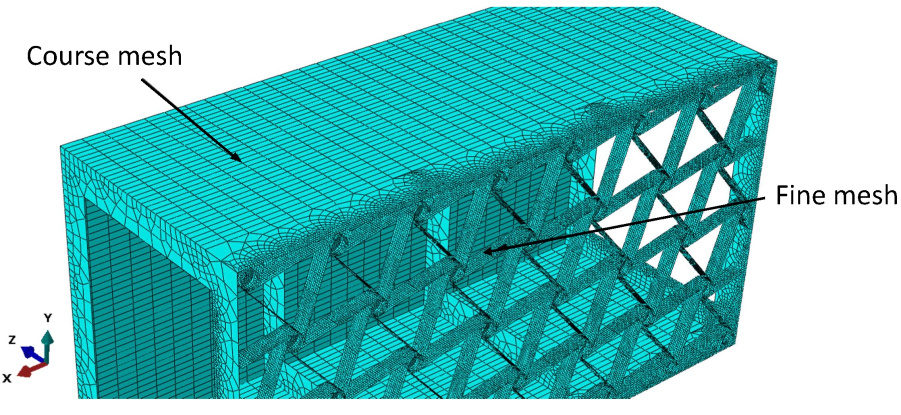
Computational model
Computational mesh description
Fine mesh size, typically equal to 3 mm.
Course mesh size, typically equal to 30 mm
Fig 26: Different mesh regions

Slide 15
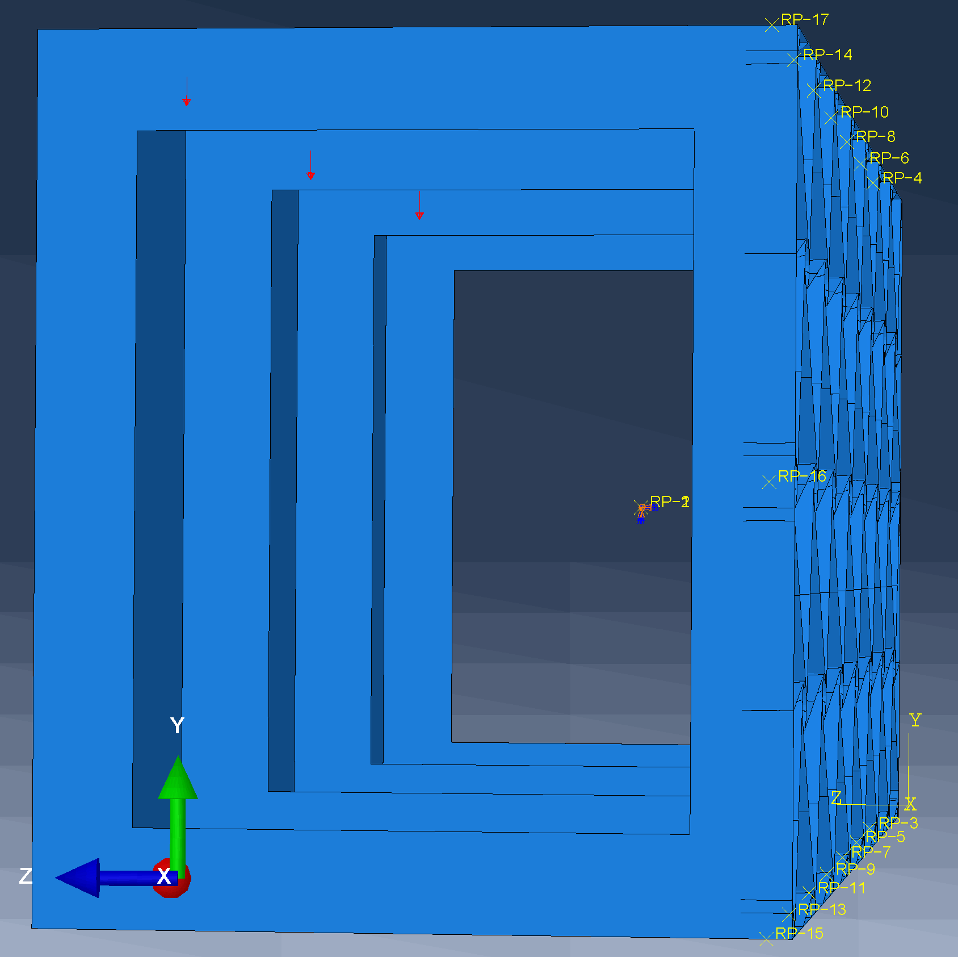
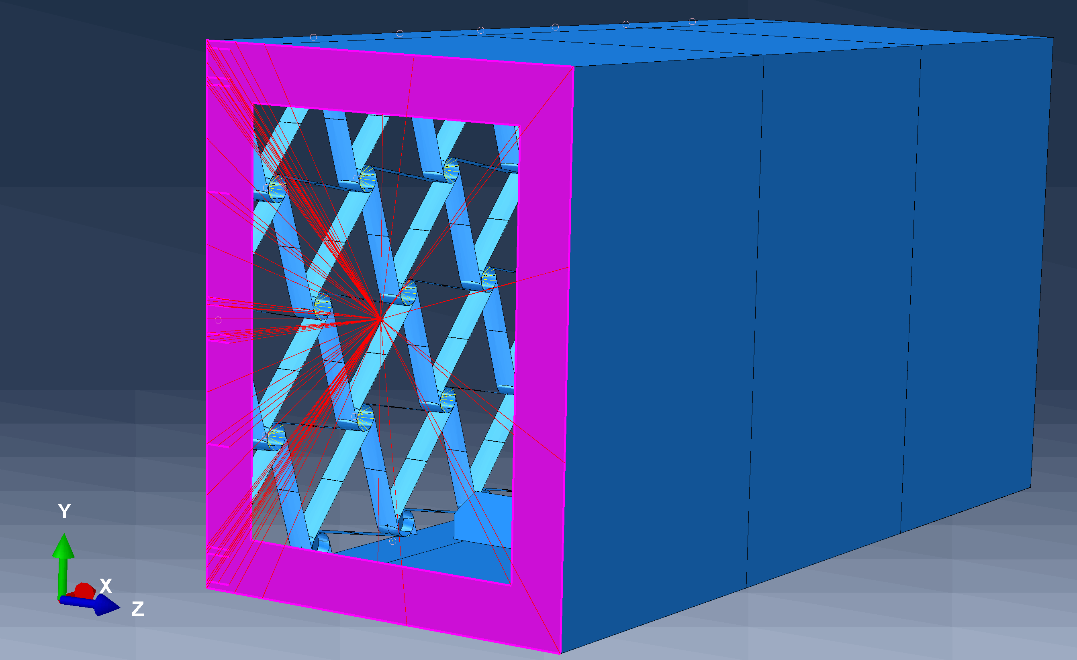
Computational model
Load introduction and boundary condition
Fig 27: Fixed boundary condition
Fig 28: Load introduction points

Slide 16
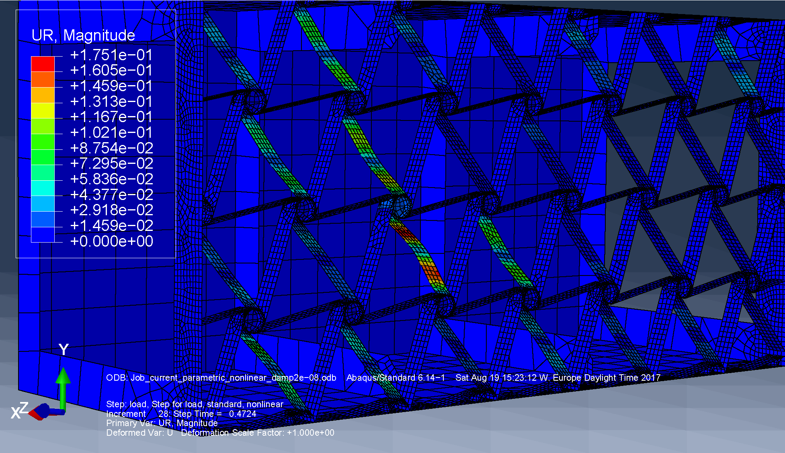
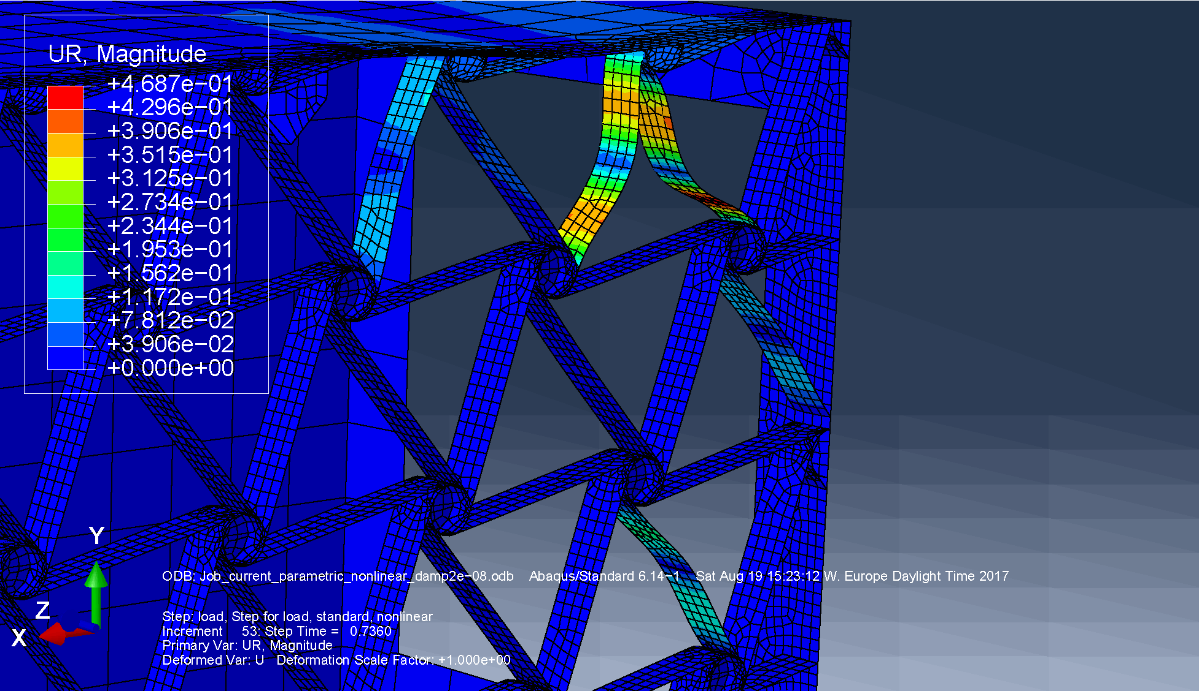
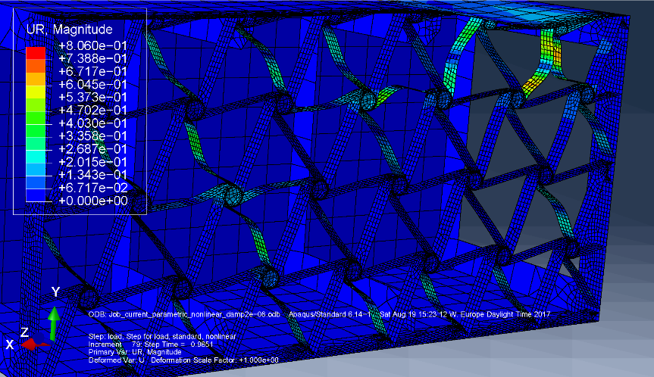
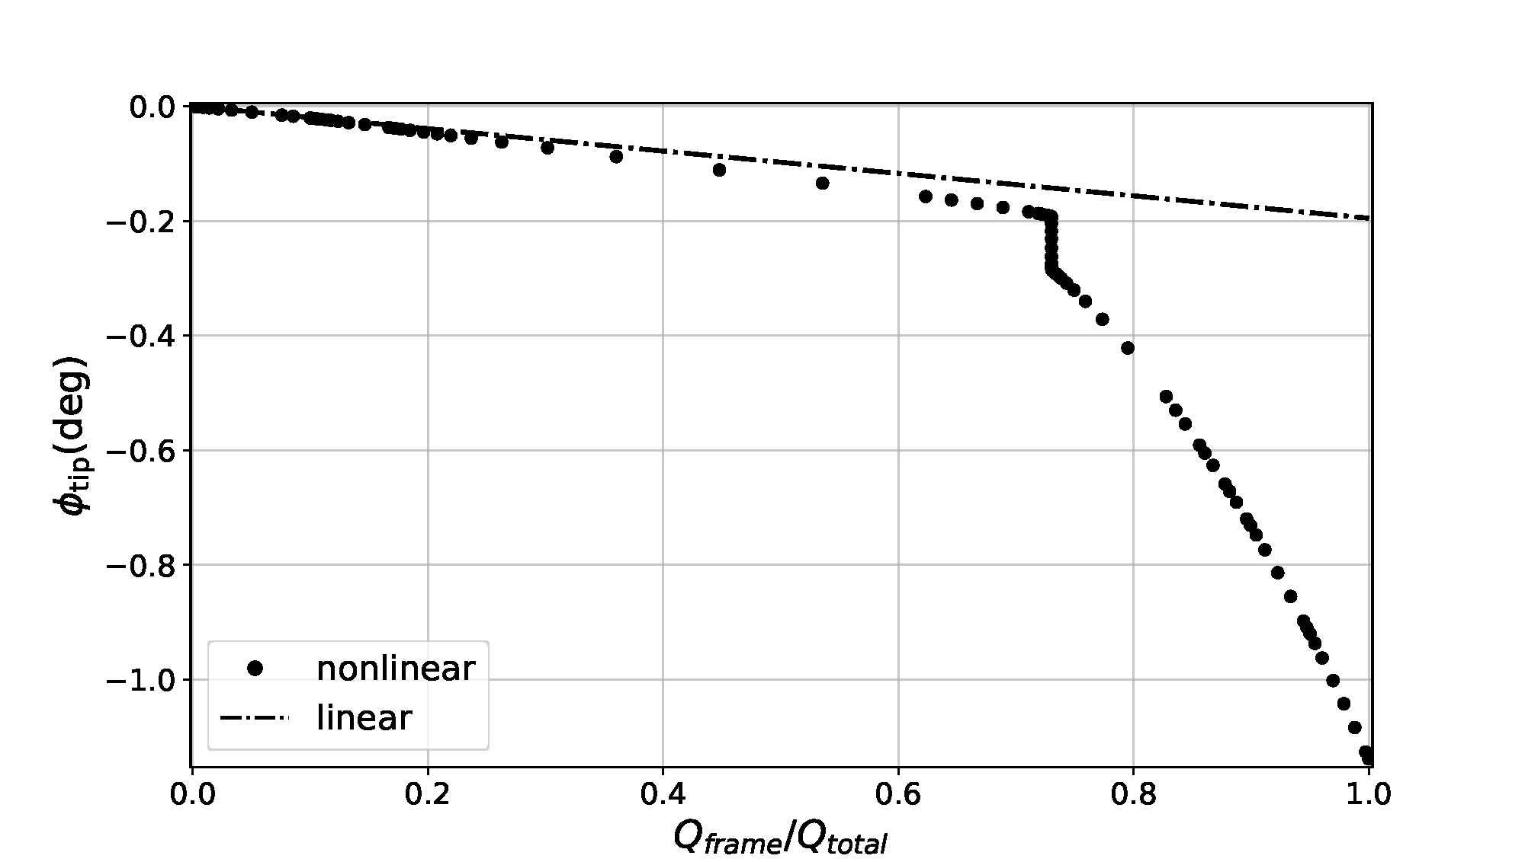
Computational model analysis
Response characterization
Fig 29: Elastic instabilities for 47% of the prescribed force applied
Fig 30: Elastic instabilities for 73% of the prescribed force applied
Fig 31: Elastic instabilities for 96% of the prescribed force applied
Fig 32: Displacement-force curve

Slide 17
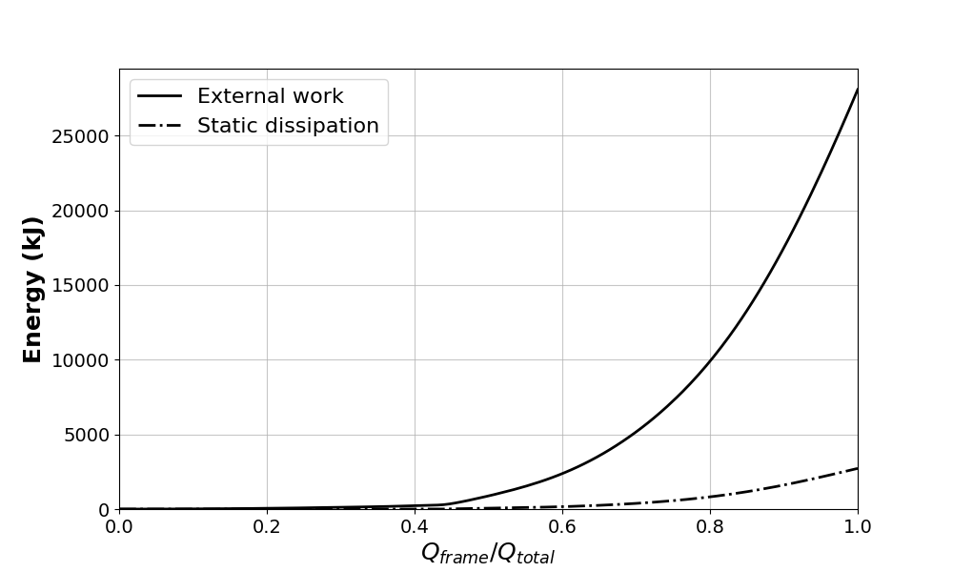
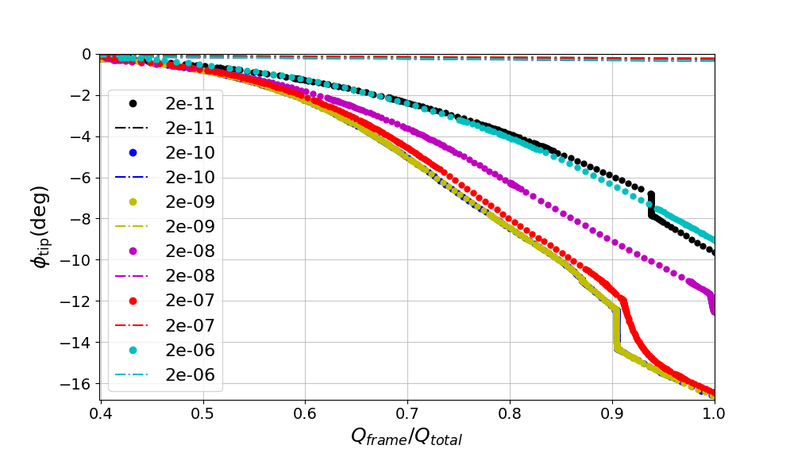
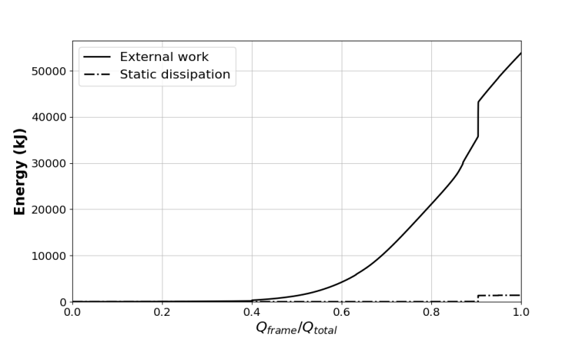
Computational model analysis
Artificial static energy dissipation using constant damping factor (c)
Fig 34: For c = 10⁻⁶
Fig 33: Displacement-force curve for various values of constant damping factor c
Fig 35: For c = 10⁻⁹

Slide 18
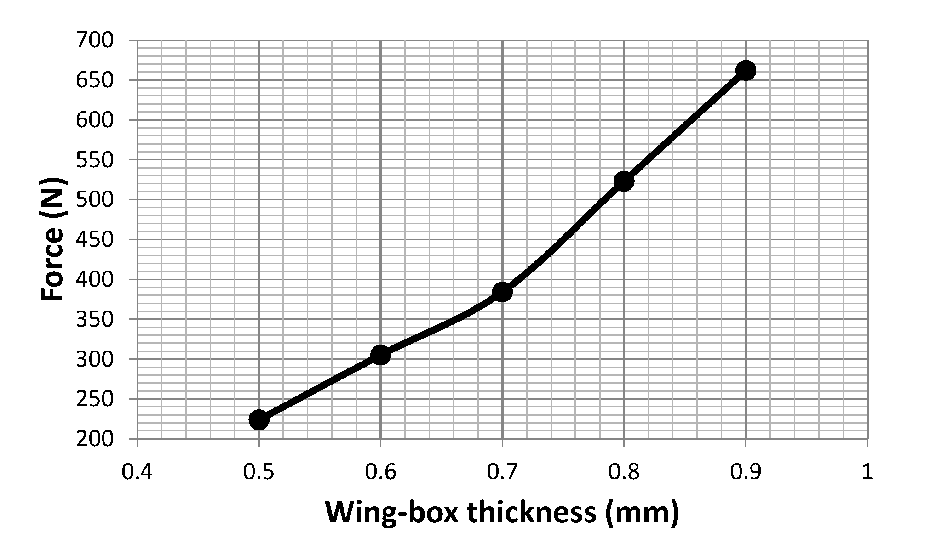
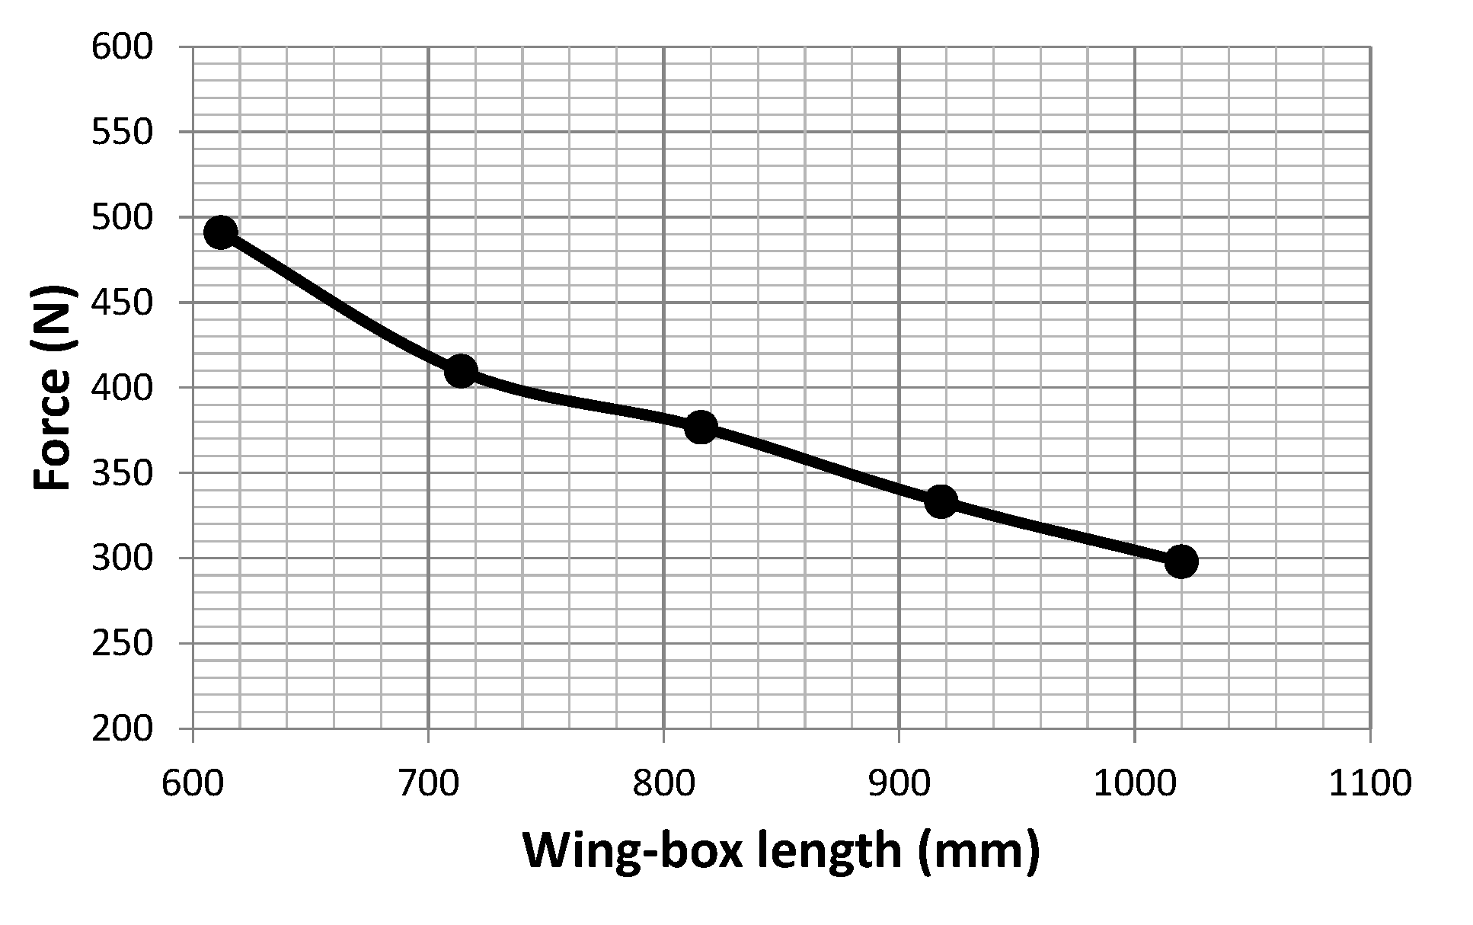
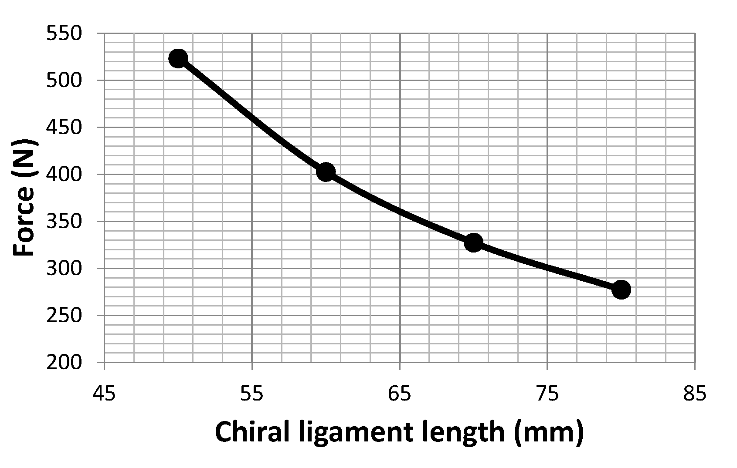
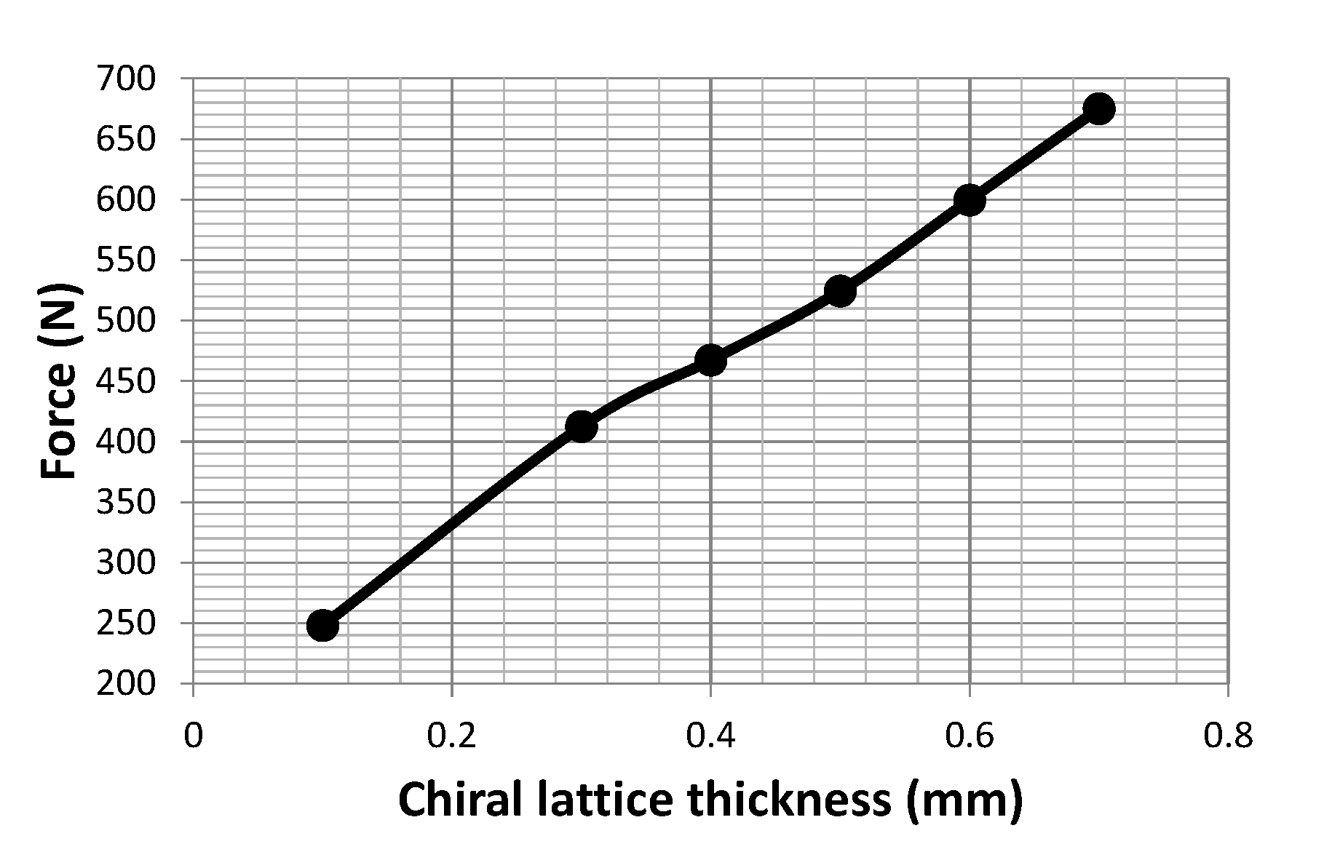
Computational model analysis
Buckling phenomena offset as function of design parameters
Fig 36: Force that induces the structure to collapse as a function of the wing-box wall thickness
Fig 37: Force that induces the structure to collapse as a function of the wing-box length
Fig 38: Force that induces the structure to collapse as a function of the chiral ligament length
Fig 39: Force that induces the structure to collapse as a function of the chiral lattice thickness

Slide 19
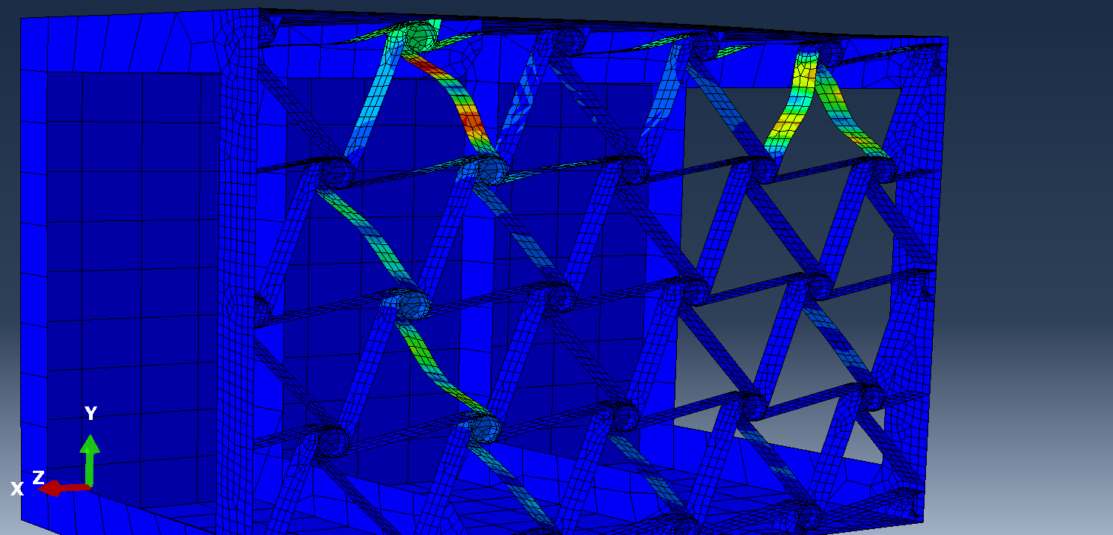
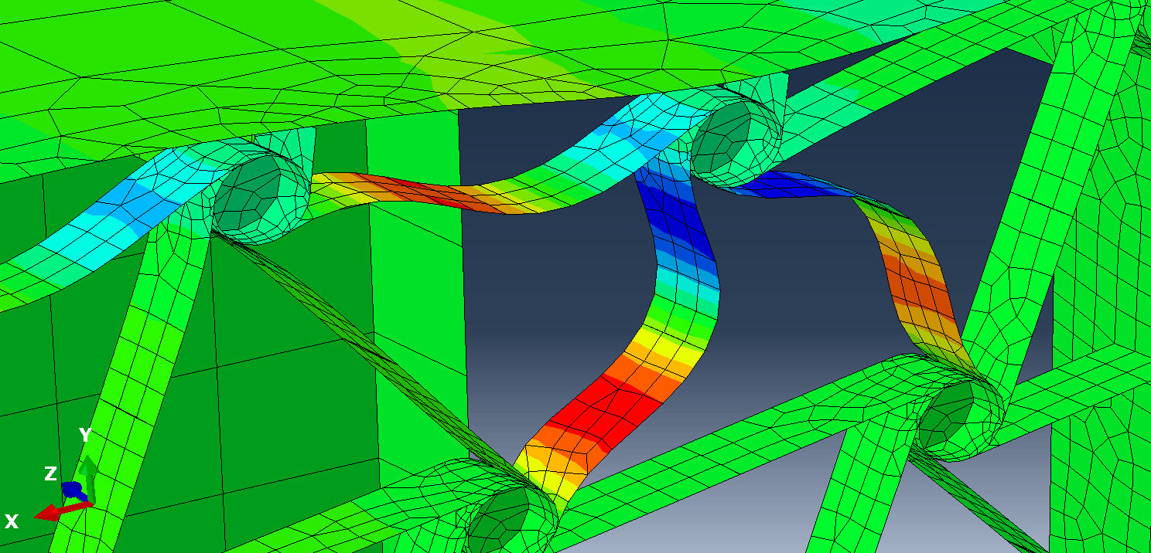
Computational model analysis
Model optimization
Two slides
Connection between the lattice nodes and the wing-box skin
Consistency analysis

Slide 20
Conclusions
Implementation of the wing-box model into a wing model with aerodynamic loads
Report finalization – Most of it is already written

Slide 21
Outlook
Implementation of the wing-box model into a wing model with aerodynamic loads
Report finalization – Most of it is already written
Manufacture of

Slide 22
References
W. Raither, A. Bergamini, F. Gandhi, and P. Ermanni, “Adaptive bending-twist coupling in laminated composite plates by controllable shear stress transfer,” in Composites Part A: Applied Science and Manufacturing, vol. 43, pp. 1709–1716, 2012.
W. Raither, A. Bergamini, and P. Ermanni, “Profile beams with adaptive bending-twist coupling by adjustable shear centre location,” Journal of Intelligent Material Systems and Structures, vol. 24, no. 3, pp. 334–346, 2013.
G. Ramstein, Experimental Validation of Chiral Structures with Local Controlled Instabilities. Semester project no. 16-015, ETH Zürich, 2016.
R. Vincenz, Airfoil camber morphing exploiting chiral structures: Manufacturing and testing. Semester project no. 17-041, ETH Zürich, 2017.

